Slide 1
Student Loan Debt:
Lesson 13.1

Slide 2
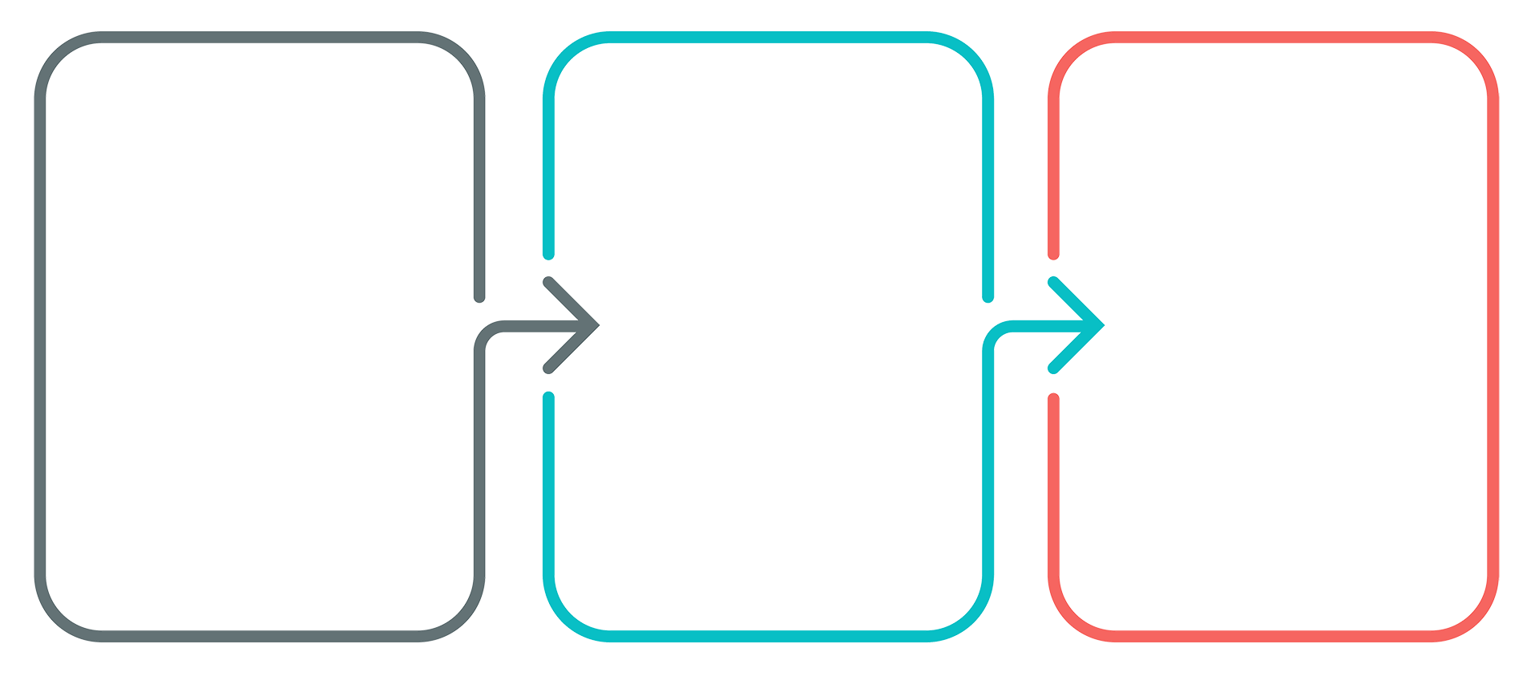
Extract, Transform, Load
Extract
We used 2 csv files: 1 on student loan debt and1 on average starting salary from highest ranked schools
Transform
We cleaned the csv files using pandas
Load
We loaded the final dataframes to SQL using sqlalchemy engine

Slide 3
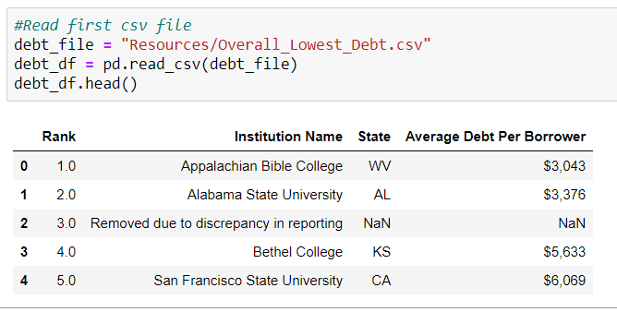
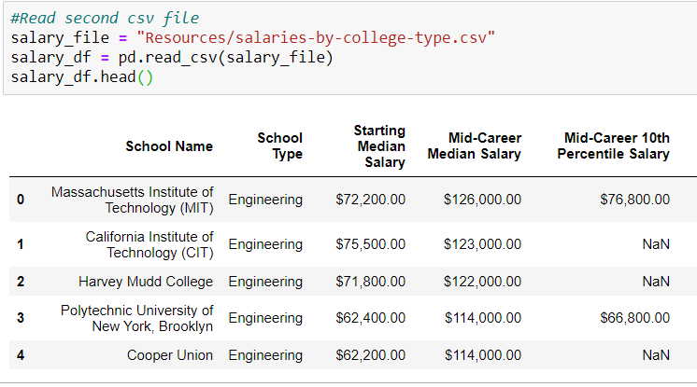
Extract Data from CSV Files & Create Dataframes
CSV File 1
CSV File 2

Slide 4
Transform the Data and Join
Data Cleaning
Summarization
Selection
Joining
Filtering
Aggregating

Slide 5
Note: We will use Python and pandas for transformation, which can also be done with SQL or a specialized ETL tool.

Slide 6



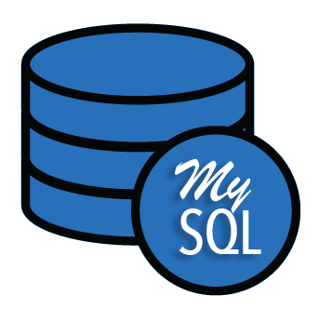
Load
Load the data into a final database that can be used
for future analysis or business use.
Can be a relational or non-relational database
Can be local or in the cloud
Can be a data lake or data warehouse
Load

Slide 7
Questions?

